Slide 1
Chapter 18 Database
簡廷因 Ting-Ying Chien
2024.12.04

Slide 2

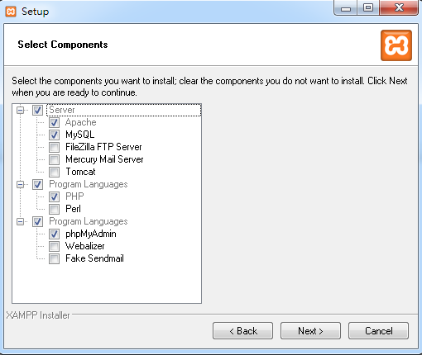
Install server
Download XAMPP
https://www.apachefriends.org/zh_tw/index.html

Slide 3
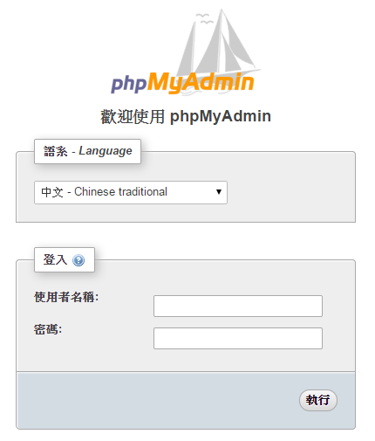
Login mysql server by phpmyadmin

Slide 4
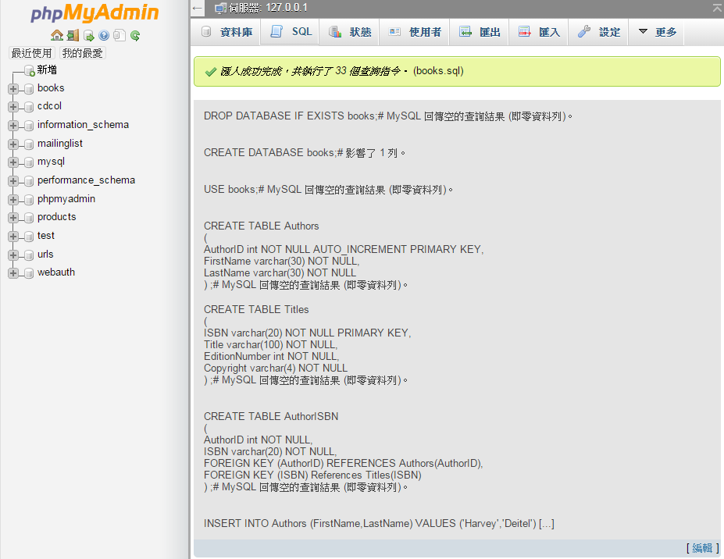
Upload example
Method 1:
首頁 -> 匯入 -> 選擇檔案 -> book.sql ->執行
Method 2:
開啟book.sql->複製->SQL -> 貼上

Slide 5
Introduction
A database is an organized collection of data.
A database management system (DBMS) provides mechanisms for storing, organizing, retrieving and modifying data for many users.
Today’s most popular database management systems are relational databases.

Slide 6
Relational Databases
A relational database stores data in tables. Tables are composed of rows, and rows are composed of columns in which values are stored.
A primary key provides unique values that cannot be duplicated in other rows of the same table.
Each column of a table represents a different attribute in a row of data.
The primary key is a column (or group of columns) with a unique value that cannot be duplicated in other rows.

Slide 7
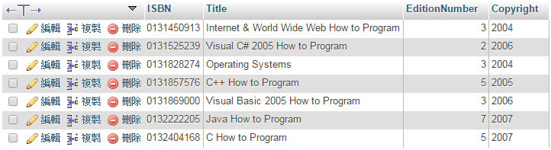
Relational Databases
books -> title

Slide 8
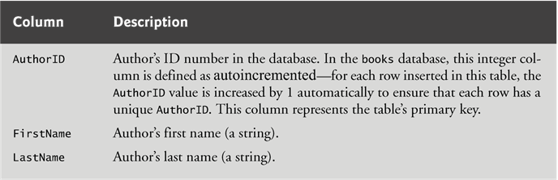
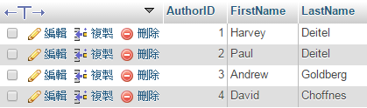
Relational Database Overview: A books Database
Authors table

Slide 9
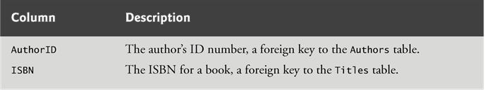
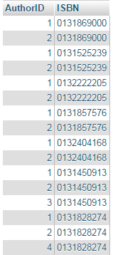
Relational Database Overview: A books Database
AuthorISMB table

Slide 10
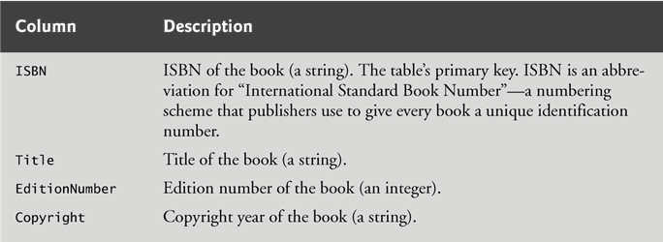
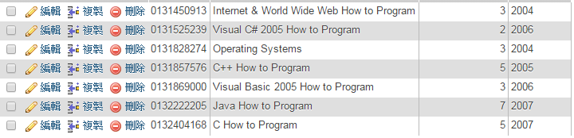
Relational Database Overview: A books Database
Titles table

Slide 11
Relational Database Overview: A books Database
The combined columns of the AuthorISBN table represent the table’s primary key—thus, each row in this table must be a unique combination of an AuthorID and an ISBN.
A one-to-many relationship between tables indicates that a row in one table can have many related rows in a separate table.

Slide 12
Relational Database Overview: A books Database
A foreign key is a column in a table that matches the primary-key column in another table.
The foreign key helps maintain the Rule of Referential Integrity: Every foreign-key value must appear as another table’s primary-key value
Foreign keys also allow related data in multiple tables to be selected from those tables for analytic purposes—this is known as joining the data

Slide 13
Relational Database Overview: A books Database
An entity-relationship (ER) diagram shows the database tables and the relationships among them.
Every row must have a primary-key value, and that value must be unique in the table. This is known as the Rule of Entity Integrity.
An infinity symbol (∞) indicates a one-to-many relationship, in which an entry from a table can have an arbitrary number of entries in another table.
A many-to-many relationship indicates that multiple entries can be related between tables.

Slide 14
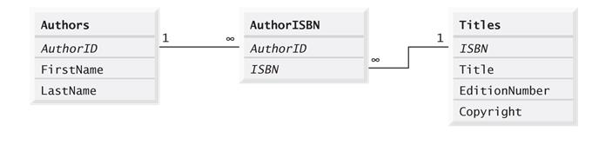
Relational Database Overview: A books Database

Slide 15
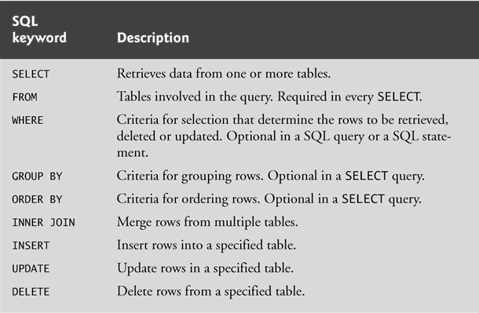
SQL

Slide 16
Basic SELECT Query
The basic form of a SELECT query is
SELECT * FROM tableName
in which the asterisk (*) wildcard character indicates that all columns from the tableName should be retrieved.
To retrieve specific columns, replace the * with a comma-separated list of column names.

Slide 17
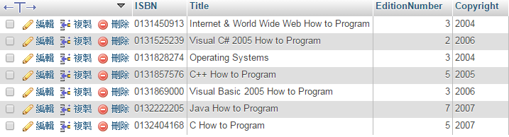
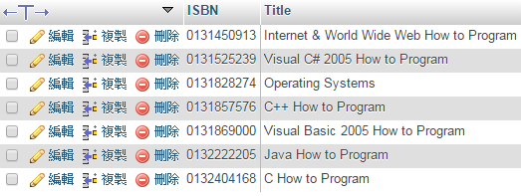
Basic SELECT Query
SELECT * FROM `titles`
SELECT `ISBN`,`Title` FROM `titles`

Slide 18
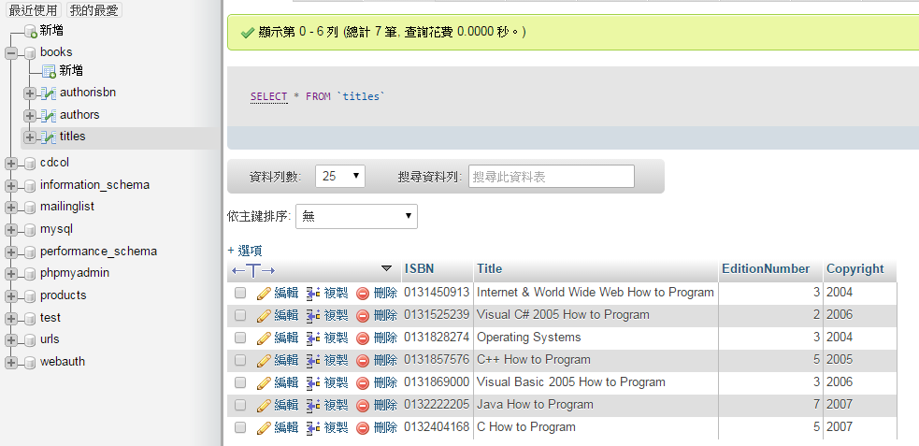
Basic SELECT Query

Slide 19
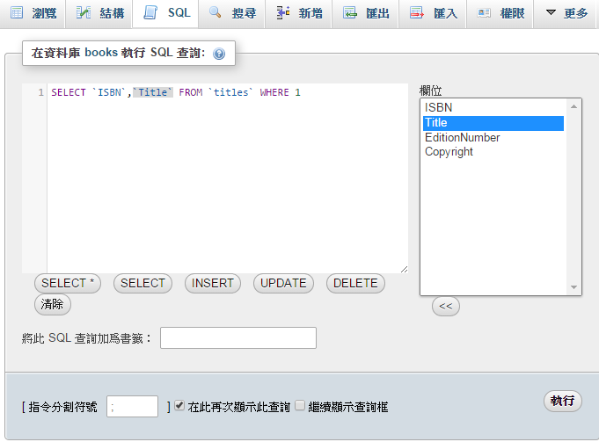
Basic SELECT Query
click
click

Slide 20
WHERE Clause
SQL uses the optional WHERE clause in a query to specify the selection criteria for the query. The basic form of a query with selection criteria is SELECT columnName1, columnName2, … FROM tableName WHERE criteria
Strings in SQL are delimited by single (') rather than double (") quotes.

Slide 21
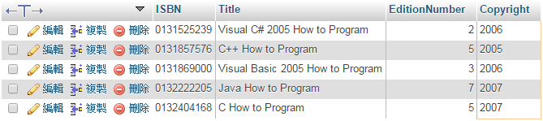

WHERE Clause
SELECT * FROM `titles` WHERE `Copyright` > 2004
SELECT * FROM `titles` WHERE `EditionNumber` > 4 AND `Copyright` > 2004

Slide 22
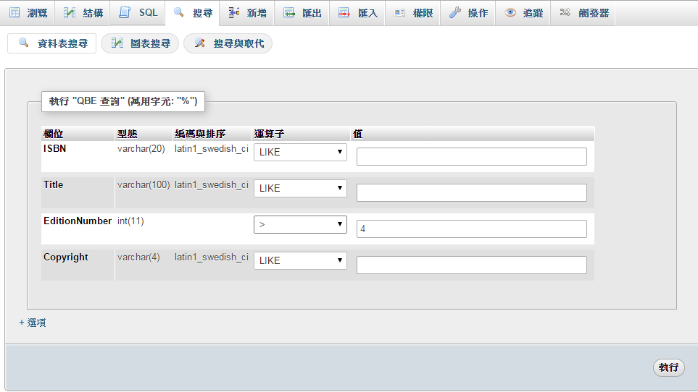
WHERE Clause

Slide 23
WHERE Clause
The WHERE clause can contain operators <, >, <=, >=, =, <> and LIKE. Operator LIKE is used for string pattern matching with wildcard characters percent (%) and underscore (_).
A percent character (%) in a pattern indicates that a string matching the pattern can have zero or more characters at the percent character’s location in the pattern.
An underscore (_) in the pattern string indicates a single character at that position in the pattern.

Slide 24
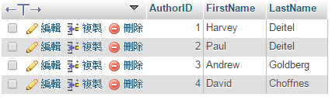

WHERE Clause
SELECT * FROM `authors’
SELECT * FROM `authors` WHERE `LastName` LIKE '_o%'

Slide 25
ORDER BY Clause
The result of a query can be sorted in ascending or descending order using the optional ORDER BY clause. The simplest form of an ORDER BY clause is
where ASC specifies ascending order, DESC specifies
descending order and column specifies the column
on which the sort is based. The default sorting order
is ascending, so ASC is optional.
SELECT columnName1, columnName2, … FROM tableName ORDER BY column ASC
SELECT columnName1, columnName2, … FROM tableName ORDER BY column DESC

Slide 26
ORDER BY Clause
Multiple columns can be used for ordering purposes with an ORDER BY clause of the form ORDER BY column1 sortingOrder, column2 sortingOrder, …
The WHERE and ORDER BY clauses can be combined in one query. If used, ORDER BY must be the last clause in the query.

Slide 27
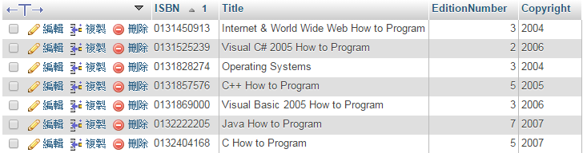
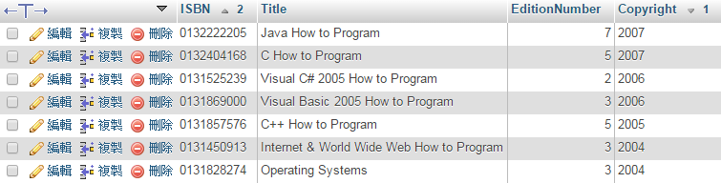
ORDER BY Clause
SELECT * FROM `titles` ORDER BY `ISBN` ASC
SELECT * FROM `titles` ORDER BY `Copyright` DESC, `ISBN` ASC

Slide 28
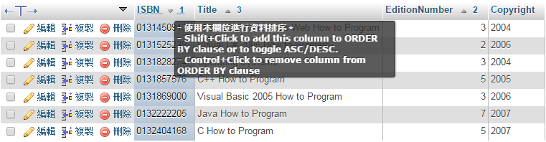
ORDER BY Clause

Slide 29
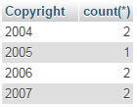
GROUP BY Clause
group values from a column
perform calculations on that column.
SELECT `Copyright`,count(*) FROM `titles` GROUP BY `Copyright`

Slide 30
Merging Data from Multiple Tables: INNER JOIN
An INNER JOIN operator merges rows from two tables by matching values in columns that are common to the tables. The basic form for the INNER JOIN operator is:
The ON clause of the INNER JOIN specifies the columns from each table that are compared to determine which rows are merged.
SELECT columnName1, columnName2, …
FROM table1 INNER JOIN table2 ON
table1.columnName = table2.columnName

Slide 31
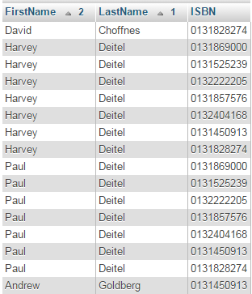
Merging Data from Multiple Tables: INNER JOIN
SELECT `FirstName`, `LastName`, `ISBN` FROM `authors` INNER JOIN `authorisbn` ON `authors`.`AuthorID` = `authorISBN`.`AuthorID` ORDER BY `LastName`, `FirstName`

Slide 32
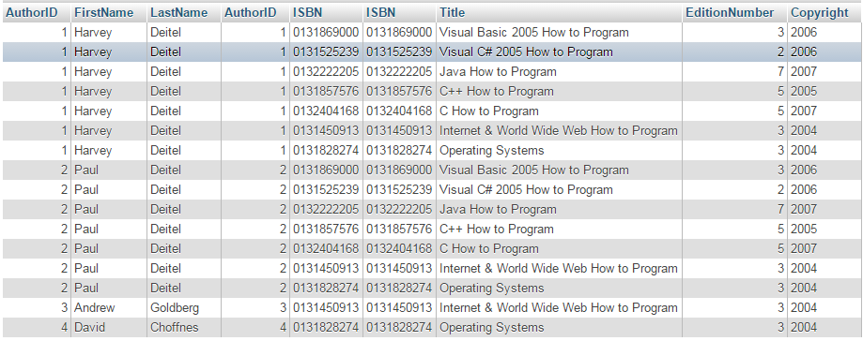
Merging Data from Multiple Tables: INNER JOIN
SELECT * FROM `authors`
INNER JOIN `authorisbn` ON `authors`.`AuthorID` = `authorISBN`.`AuthorID`
INNER JOIN `titles` ON `authorisbn`.`ISBN` = `titles`.`ISBN`

Slide 33
Exercise
Upload ch18.sql
1. Merge table (Summary, Dist_info, Type_info)
2. 列出所有中壢區房子的交易價
3. 計算各區房子的平均交易價
Hint: avg function

Slide 34
INSERT Statement
An INSERT statement inserts a new row into a table. The basic form of this statement is
where tableName is the table in which to insert the
row. The tableName is followed by a comma-separated
list of column names in parentheses. The list of column
names is followed by the SQL keyword VALUES and a
comma-separated list of values in parentheses.
INSERT INTO tableName ( columnName1, columnName2, …, columnNameN ) VALUES ( value1, value2, …, valueN )

Slide 35
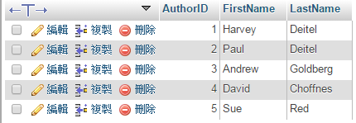
INSERT Statement
INSERT INTO `authors` ( `FirstName`, `LastName` ) VALUES ( 'Sue', 'Red' )

Slide 36
INSERT Statement
We do not specify an AuthorID in this example because AuthorID is an autoincremented column.
For every row added to this table, the DBMS assigns a unique AuthorID value that is the next value in the autoincremented sequence (i.e., 1, 2, 3 and so on). In this case, Sue Red would be assigned AuthorID number 5.
CREATE TABLE Authors
(
AuthorID int NOT NULL AUTO_INCREMENT PRIMARY KEY,
FirstName varchar(30) NOT NULL,
LastName varchar(30) NOT NULL
)

Slide 37
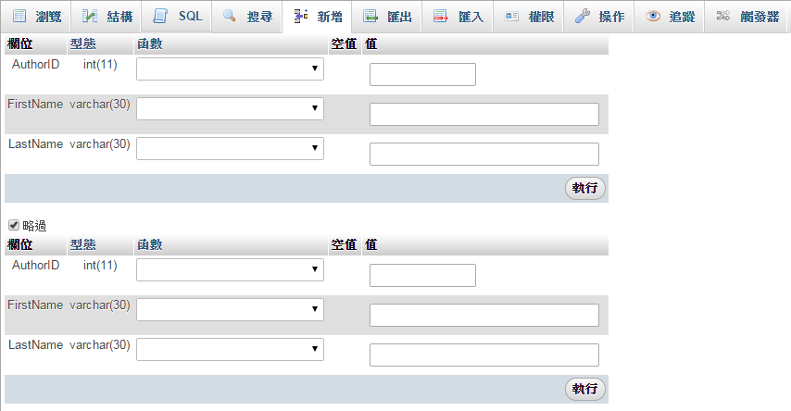
INSERT Statement

Slide 38
UPDATE Statement
An UPDATE statement modifies data in a table. Its basic form is
where tableName is the table in which to update data. The tableName is followed by keyword SET and a comma-separated list of column name/value pairs in the format columnName = value. The optional WHERE clause criteria determines which rows to update.
UPDATE tableName SET columnName1 = value1, columnName2 = value2, …, columnNameN = valueN WHERE criteria

Slide 39
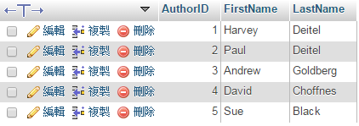
UPDATE Statement
UPDATE `books`.`authors` SET `LastName` = 'Black' WHERE `authors`.`AuthorID` = 5

Slide 40
UPDATE Statement

Slide 41
DELETE Statement
A SQL DELETE statement removes rows from a table. Its basic form is
where tableName is the table from which to delete a row (or rows). The optional WHERE criteria determines which rows to delete. If this clause is omitted, all the table’s rows are deleted.
DELETE FROM tableName WHERE criteria

Slide 42
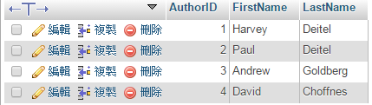
DELETE Statement
DELETE FROM `authors` WHERE `AuthorID` =5

Slide 43
DELETE Statement

Slide 44
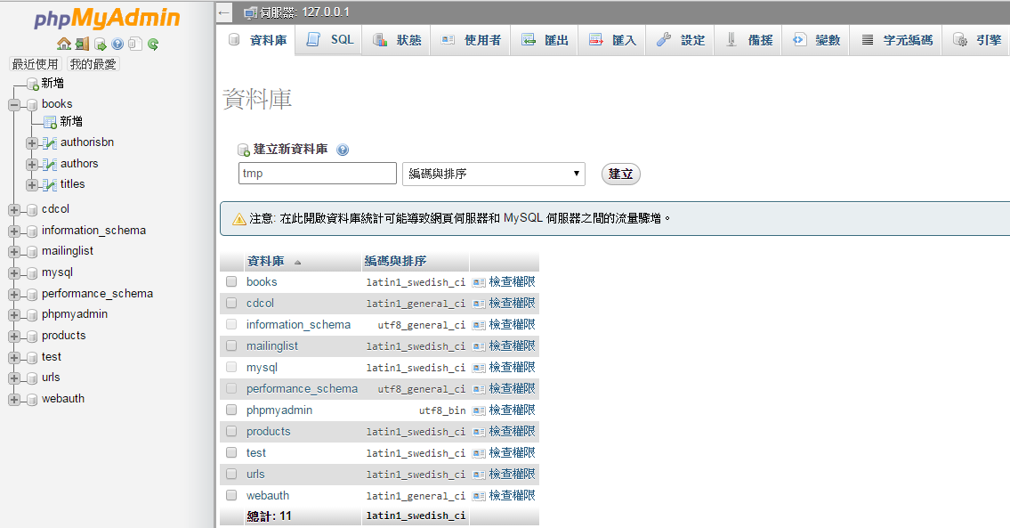
Create Database
CREATE DATABASE DBNAME
DBNAME

Slide 45
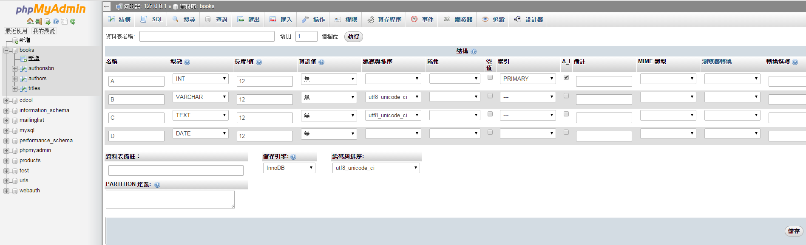
Create Table

Slide 46
Q&A

